Slide 1
part | name | Price | source | link
CPU | 7800x3D (80w) | 1831 box | ksp | https://tms.co.il/index.php?route=product/product&product_id=108125
Motherboard | ASUS TUF GAMING B650-PLUS ATX | 1,170 | ksp | https://ksp.co.il/web/item/233737 You should update the BIOS, just as you should with any new system
gpu | 4070 FE | 2780 | youski
ram | Corsair Vengeance RGB 2x16GB DDR5 5200MHz CL40 | 499 | ksp | https://ksp.co.il/web/item/219254
Storge | Samsung 990 PRO NVMe M.2 2280 1TB SSD | 555 | ksp | https://ksp.co.il/web/item/236684
psu | Asus ROG Loki SFX-L 750W atx 3.0 850w,1055 | 915ils | ksp | https://ksp.co.il/web/item/279339
Cpu cooler | Noctua NH-U12S chromax.black | 295 | ksp | https://ksp.co.il/web/item/158825
Fans | No need
case | Pure Base 500 Metalick window 2fan instaleed | 421 tms | tms
 |  | 8466

Slide 3
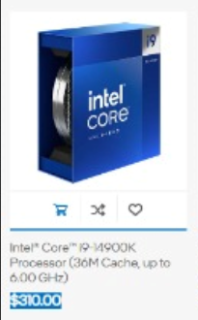
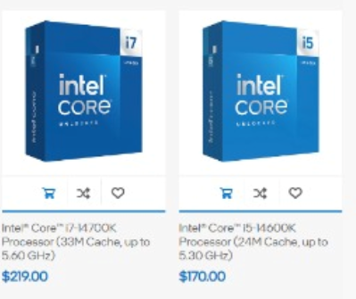
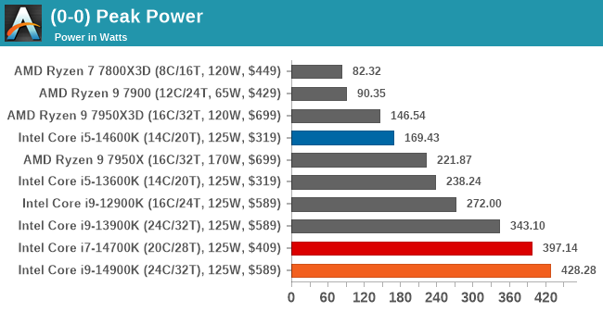
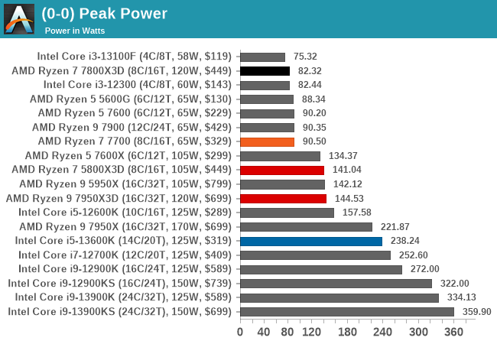
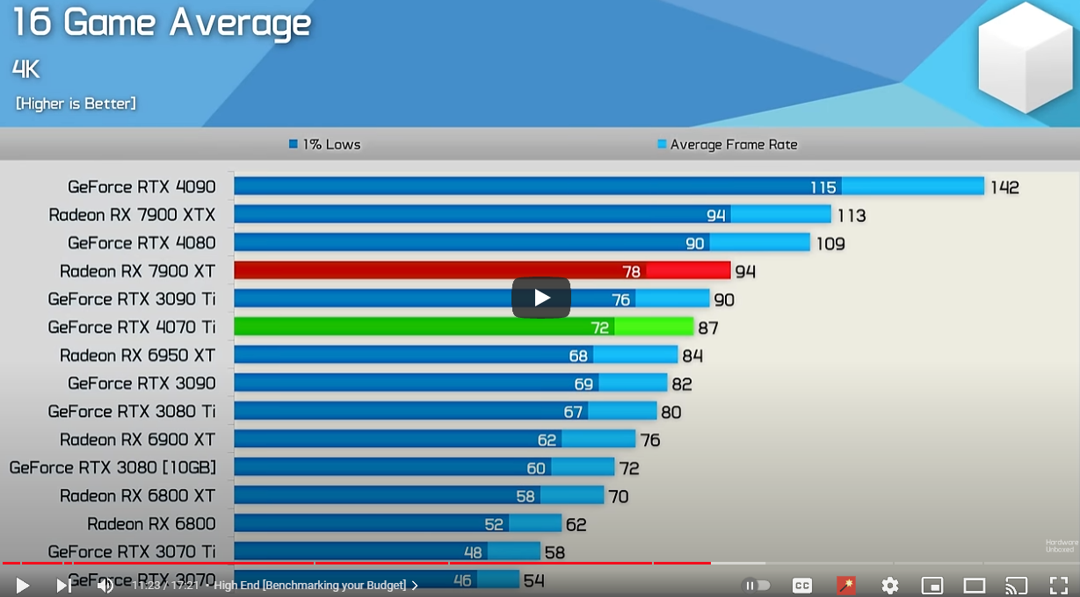
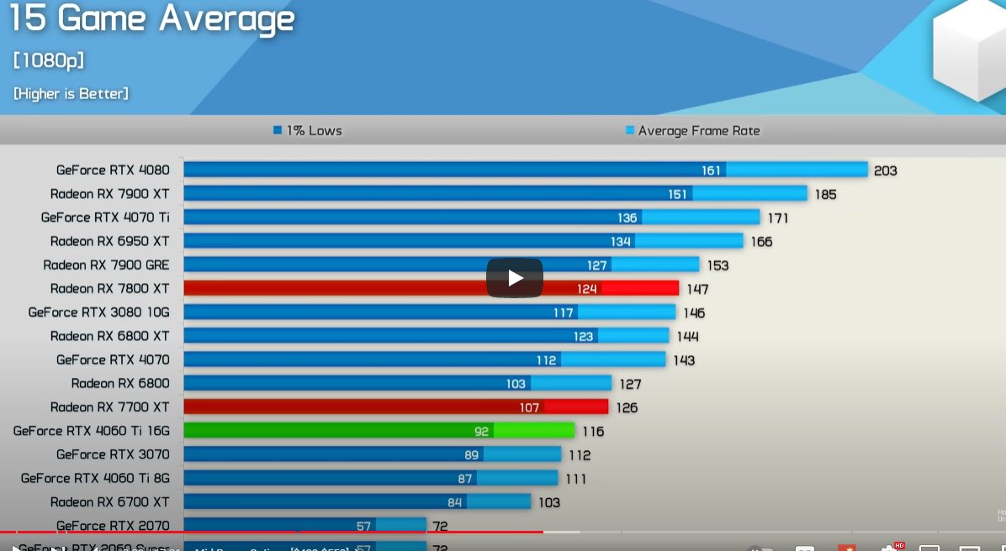
https://cultists.network/140/psu-tier-list/
Cpu | 7800x3D (80w) | 2335 ksp, 1763 tms tray
Motherboard | Asus b650m-plus | 1000
gpu | 4070 | 2750 youski
ram | 2x16 entry ddr5 | 480
Storge | 1tb nvme samung gen 4 | 555
psu | Asus ROG Loki SFX-L 750W atx 3.0 | 915ils ksp
Cpu cooler | NH-U12S | 357 tms
Fans | No need
case | Pure Base 500 Metalick window 2fan instaleed | 421 tms
Cpu | Intel i9 14900k (430w) 8+ 16 Intel i7 14700k (397w) 8+12 Intel i5 14600k (170w) 6+8 | 1350ils 960ils 750ils | 900 benfit
Motherboard |  |  | 200 extra?
gpu
ram | 2x16 entry ddr5 | 480 | 100 extra?
Storge | 1tb nvme samung gen 4 | 555
psu | Asus ROG Loki SFX-L 1000w atx 3.0 | 1230ils ksp | 300 extra,1000w
Cpu cooler | NH-D15(ram clear) | 491 tms | 134 extra
Fans | NF-S12A black | 112 tms x3 | 336 extra
case | corsair 3000D AIRFLOW | 355 ksp
GPU | 4070 12gb(200w) | 3300 ksp 3100tms | 2750 yusski
 | 7800 XT 16gb(250w) | 2900ksp 2500tms
 | 3080 (320w) 6800xt 16 gb
 | 4070ti 12gb | 4200 same
 | 7900XTX 24gb (beeter than 4080) 7900XT 20gb | 4800ksp 4500tms
 | 4080 16 | 5600 | 5150 yusski
 | 12vhpwr power starts from 4070 Ti.
psu | Tuf gold 750w | 680
 | Be quiet 750w Darkpoer pro 11 | 825 tms
 | Asus ROG Loki SFX-L 750W atx 3.0 | 915ils ksp

Slide 4
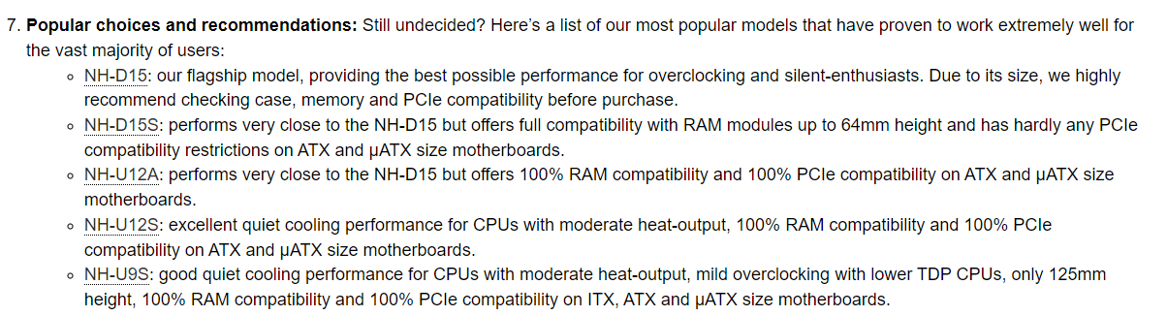
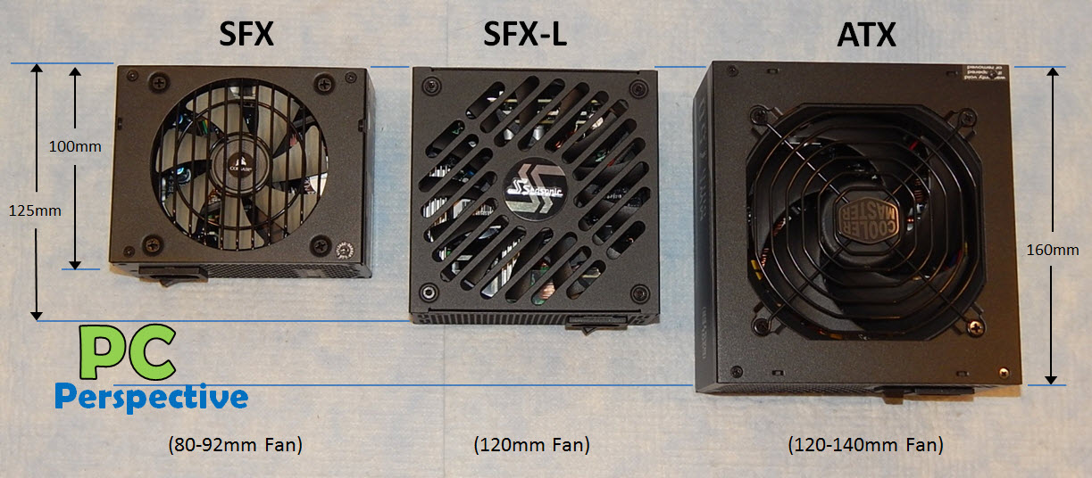
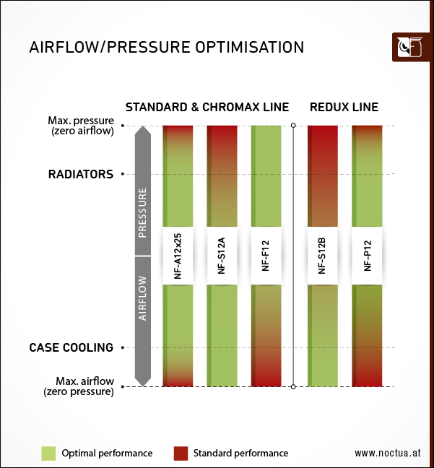
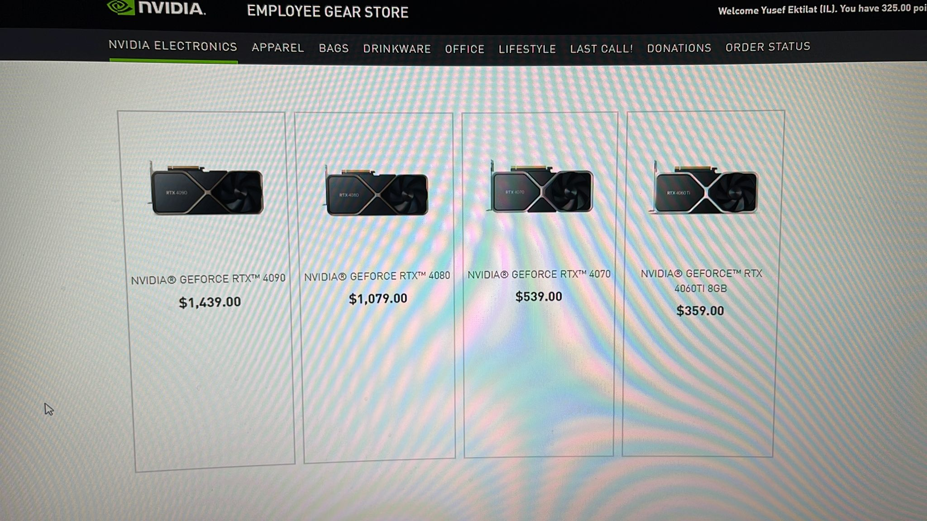
Yousif
4070 | 127usd 98usd | 540usd | 2,759 ils
4080 | 237 taxes 106usd | 1080usd | 5,132

